Slide 1
CREATING GRAPHS
Picture Graphs and Step Graphs

Slide 2

Key features of graphs
What do we need for a graph?
What makes a good graph
How and why do we use graphs.

Slide 3
Painting a Picture (graph)
EQ
How do we make picture graphs and what are they used for?
A picture graph is made of representational units.
Each unit needs to represent the same amount and be of the same size.
A key is required to describe how much each image represents.
Picture graphs can be used to compare multiple data sets, or different data on a similar subject- e.g. The number of letters delivered daily, or the number of each animal on a station or farm.

Slide 4
How do we make a Picture Graph?
EQ
How do we make picture graphs and what are they used for?
Making a picture graph requires a few things:
Data – either numerical or categorical.
A Picture - its in the name, but something appropriate or related to the data.
A set of axes
Similar to a bar or column graph, either axis can be the number, and the other is the categorical data by default.

Slide 5
Practising Picture Graphs
EQ
How do we make picture graphs and what are they used for?
Using the data below, lets practise making a picture graph.
Sam collects data about the amount of pizzas he sells. He sells 40 on Monday, 60 on Tuesday, 100 on Wednesday, and on Thursday and Friday he sells 150 pizzas each.
Select a picture to use for this graph- appropriate to the circumstance.
Determine how much each picture is equal to, i.e. 1 picture is 2 pizzas, 1 picture is 5 pizzas ect.
Label your axes with the required data.

Slide 6
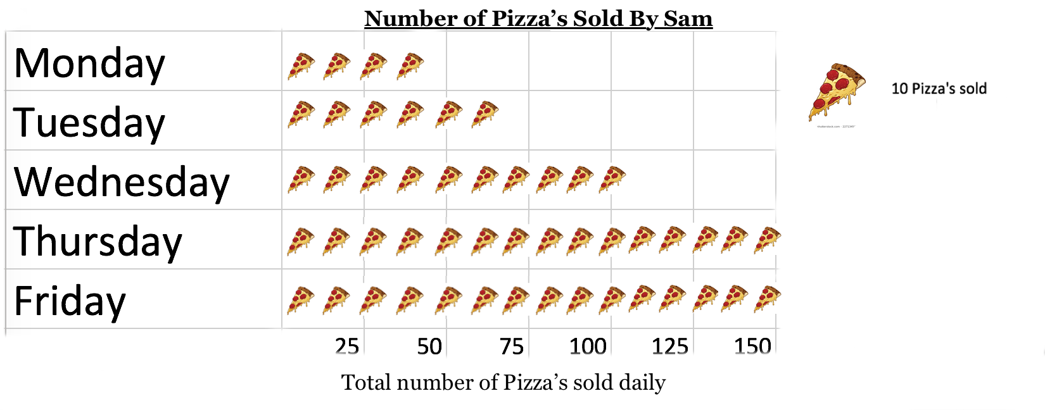
PIZZA GRAPH
EQ
How do we make picture graphs and what are they used for?
How does this graph stack up?
Does it show the information?
Is it easily readable?
Is it easier to determine how many pizzas he sold in total?

Slide 7
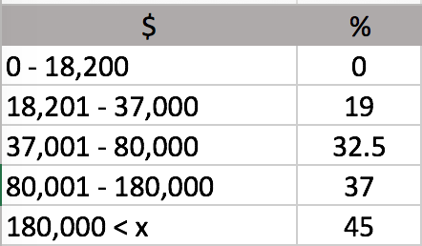
Making a step graph
EQ
What is a step graph and where are they used in real life?
Step graphs are a useful function for showing differences in values that are not linear, but are related.
Step graphs are commonly used for financial situations, such as determining taxi fare costs, or the amount of tax someone needs to pay.
They have short lines, with open or closed circles at either end
An open circle at the start of a line means that point is excluded, where an closed circle include it.
The taxation amounts for income in Australia is listed right.
Construct a step graph to represent this information.

Slide 8
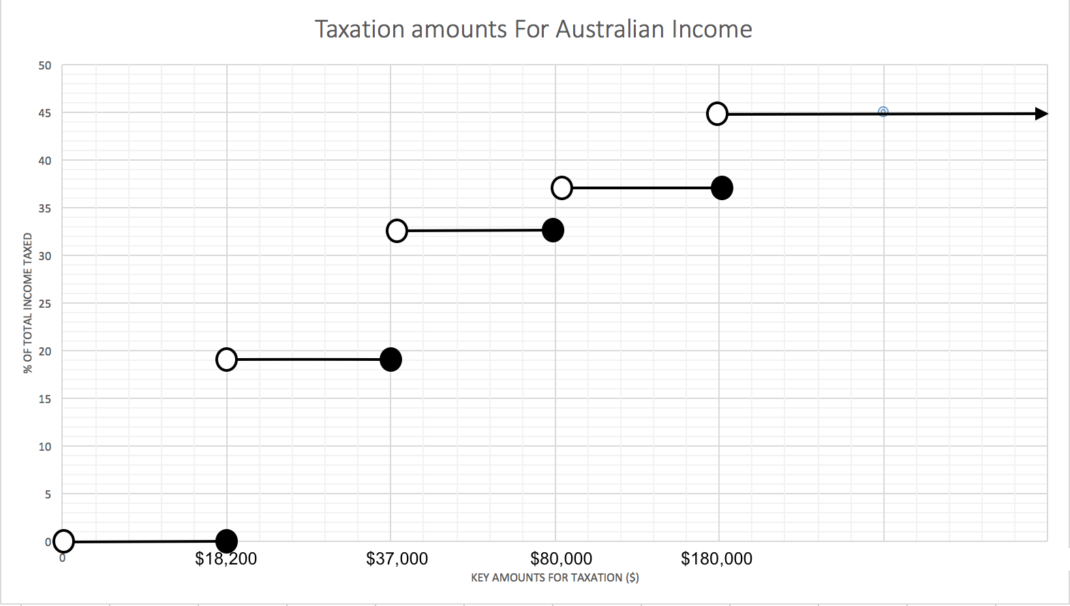
How does it look?
Notice that the open circles are above the indicated amounts?
This is because the amounts are the end points for each bracket, not the start.
Because of $18,201 being the beginning of taxable income, earning $18,200 would mean you pay no tax.

